Slide 1
AN INTRODUCTION TO
TWO WAY ANOVA
Course - Bio Statistics

Slide 2
ONE WAY ANOVA
TYPES OF ANOVA
TWO WAY ANOVA

Slide 3

HOW THEY DIFFER?
ANOVA
One-Way ANOVA
Two way ANOVA
One independent variable
Two independent Variables

Slide 4
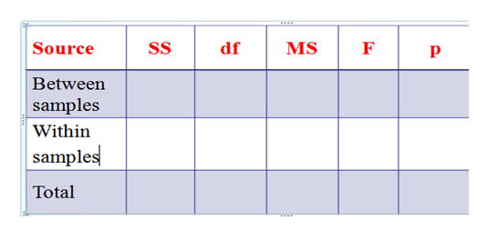
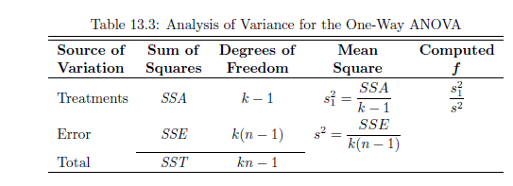

One Way Anova
In one way Anova the table layout was:

Slide 5
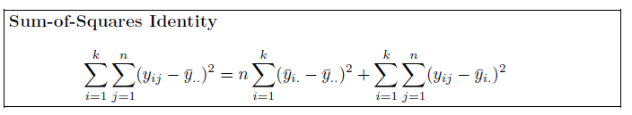
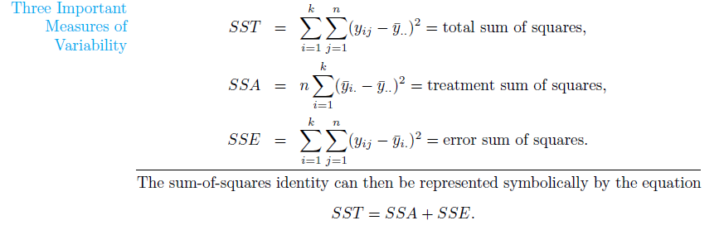
One Way Anova

Slide 6

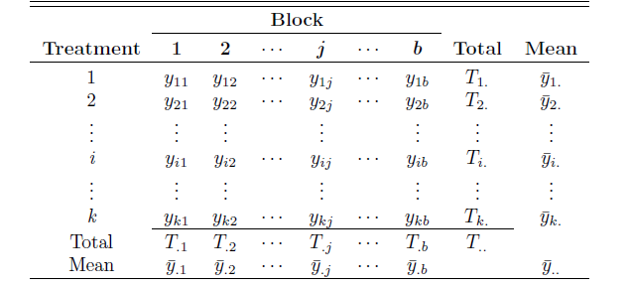
Assumptions of two way Anova

Slide 7
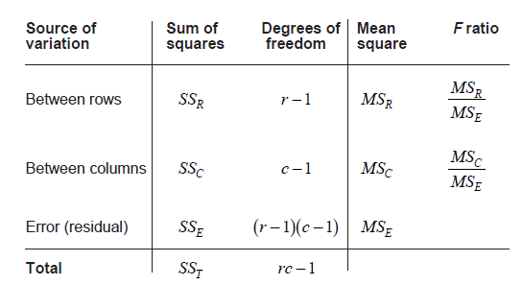
Two Way Anova Table

Slide 8
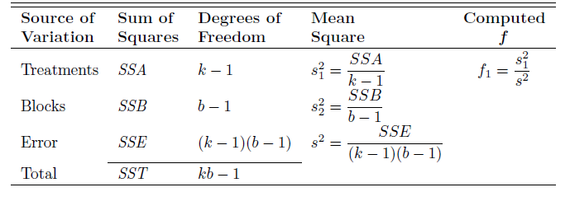
Two Way Anova Table

Slide 9
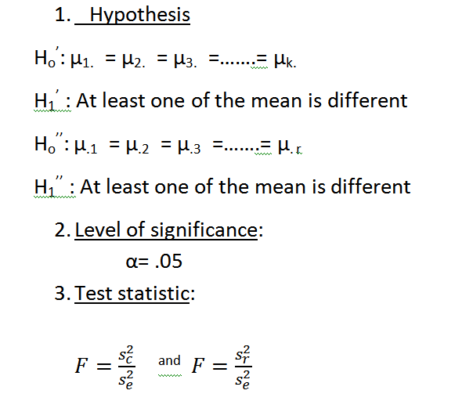
Steps for two way Anova

Slide 10
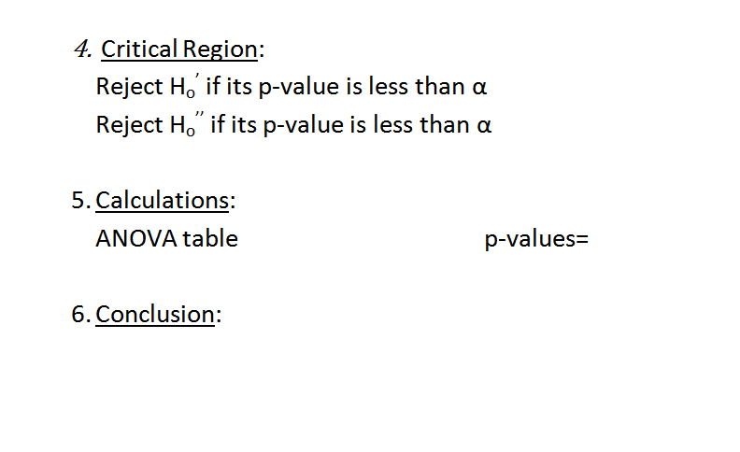
Steps for two way Anova

Slide 11
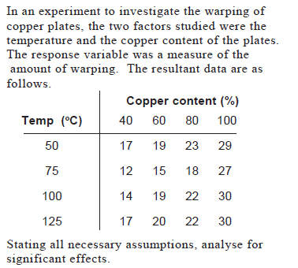
Question

Slide 12
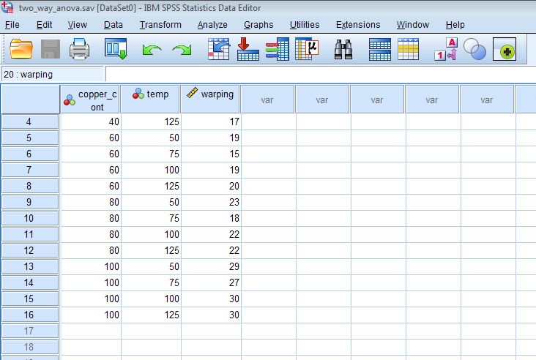
How to Conduct two way Anova on SPSS

Slide 13
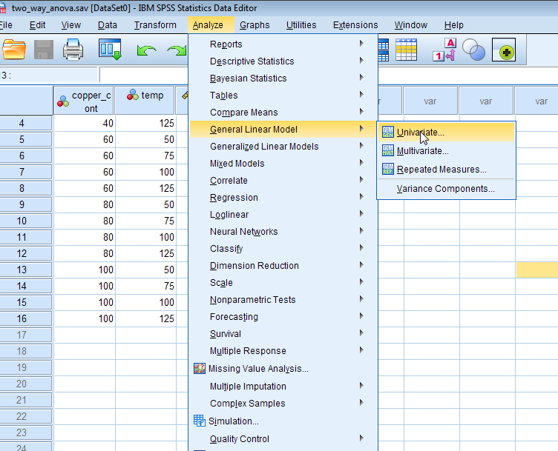
How to Conduct two way Anova on SPSS

Slide 14
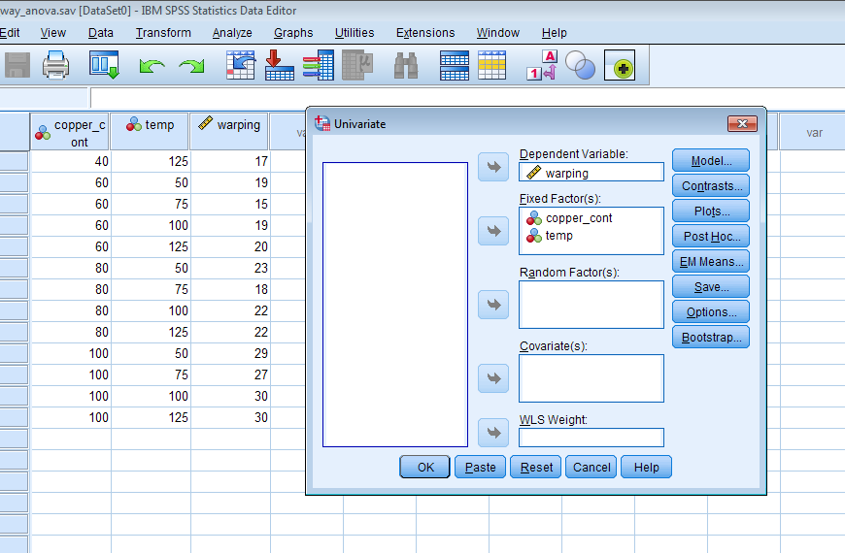
How to Conduct two way Anova on SPSS

Slide 15
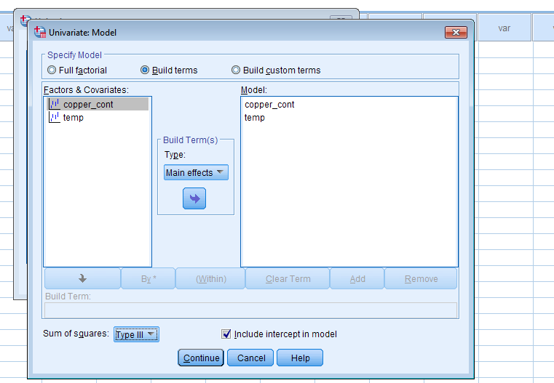
How to Conduct two way Anova on SPSS

Slide 16
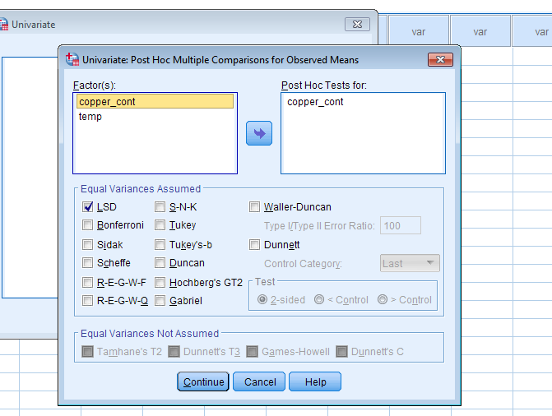
How to Conduct two way Anova on SPSS

Slide 17
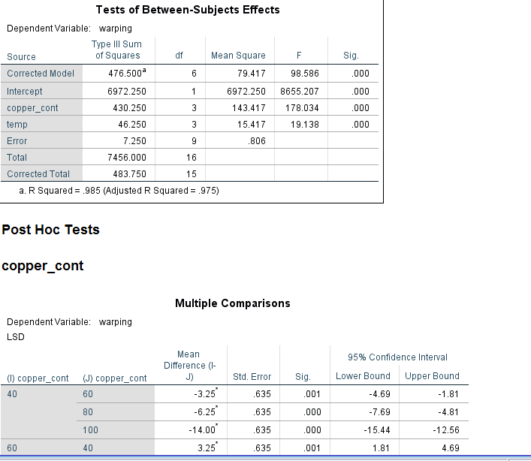
Results

Slide 18
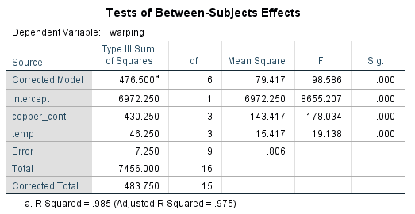
Results

Slide 19
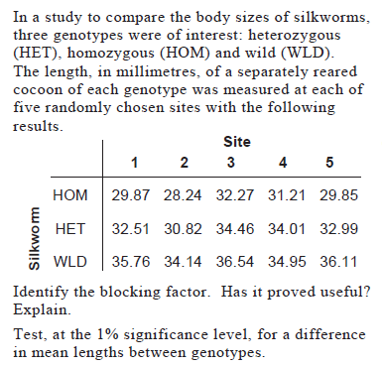
Question

Slide 20
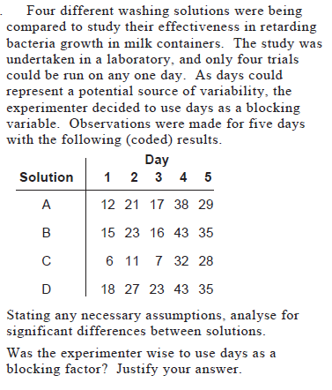
Question

Slide 21



The End…!!!

